Slide 1
Capstone Project (Supervised ML Regression)
Appliances Energy Prediction by Abhijeet Dutta

Slide 2
AGENDA
Introduction
Problem Statement
Variable Explanation
Data Overview
Basic Exploratory Data Analysis
Data Cleaning
Feature Engineering (VIF)
Model Building
Evaluating the model performances
Hyperparameter Tuning
Stacking
Conclusion

Slide 3
INTRODUCTION
Supervised learning is the types of machine learning in which machines are trained using well "labelled" training data, and on basis of that data, machines predict the output. The labelled data means some input data is already tagged with the correct output. Supervised learning is a process of providing input data as well as correct output data to the machine learning model. The aim of a supervised learning algorithm is to find a mapping function to map the input variable(x) with the output variable(y).
In the real-world, supervised learning can be used for Risk Assessment, Image classification, Fraud Detection, spam filtering, etc.
Energy prediction of appliances requires identifying and predicting individual appliance energy consumption when combined in a closed chain environment. This experiment aims to provide insight into reducing energy consumption by identifying trends and appliances involved.

Slide 4
PROBLEM STATEMENT :
The data set is at 10 min for about 4.5 months. The house temperature and humidity conditions were monitored with a ZigBee wireless sensor network. Each wireless node transmitted the temperature and humidity conditions around 3.3 min. Then, the wireless data was averaged for 10 minutes periods. The energy data was logged every 10 minutes with m-bus energy meters. Weather from the nearest airport weather station Chievres Airport, Belgium) was downloaded from a public data set from Reliable Prognosis (rp5.ru) and merged together with the experimental data sets using the date and time column. Two random variables have been included in the data set for testing the regression models and to filter out non-predictive attributes (parameters).

Slide 5
VARIABLE EXPLANATION :
date time year-month-day hour: minute: second
Appliances, energy use in Wh (Dependent variable)
lights, energy use of light fixtures in the house in Wh (Drop this column)
T1, Temperature in kitchen area, in Celsius
RH1, Humidity in kitchen area, in % T2, Temperature in living room area, in Celsius
RH2, Humidity in living room area, in %
T3, Temperature in laundry room area
RH3, Humidity in laundry room area, in %
T4, Temperature in office room, in Celsius
RH4, Humidity in office room, in %
T5, Temperature in bathroom, in Celsius
RH5, Humidity in bathroom, in % T6, Temperature outside the building (north side), in Celsius
RH6, Humidity outside the building (north side), in %
T7, Temperature in ironing room , in Celsius
RH7, Humidity in ironing room, in %
T8, Temperature in teenager room 2, in Celsius

Slide 6
VARIABLE EXPLANATION :
RH8, Humidity in teenager room 2, in %
T9, Temperature in parents room, in Celsius
RH9, Humidity in parents room, in % ,
Tout, Temperature outside (from Chievres weather station), in Celsius
Pressure, (from Chievres weather station), in mm Hg
RHout, Humidity outside (from Chievres weather station), in %
Wind speed (from Chievres weather station), in m/s
Visibility (from Chievres weather station), in km
Tdewpoint (from Chievres weather station), Â°C
rv1, Random variable 1, nondimensional
rv2, Random variable 2, nondimensional

Slide 7
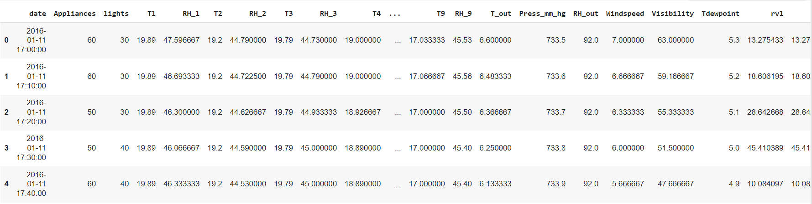
DATA OVERVIEW :
There are 19735 rows and 29 columns in the Appliance Energy Prediction Dataset.

Slide 8
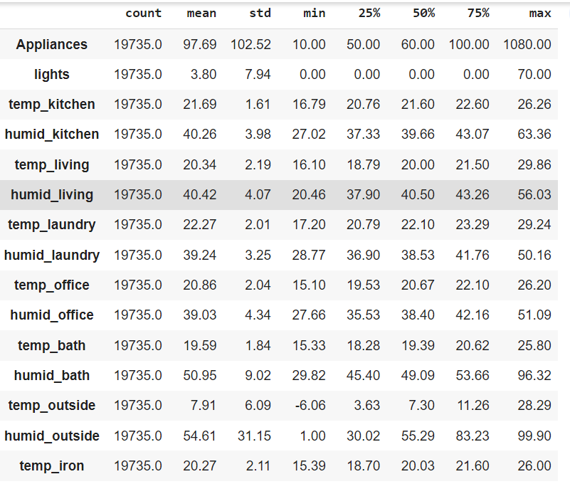
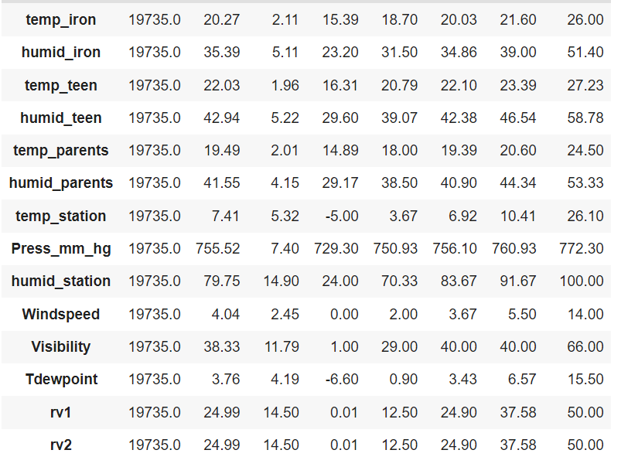
DESCRIPTIVE STATISTICS:

Slide 9
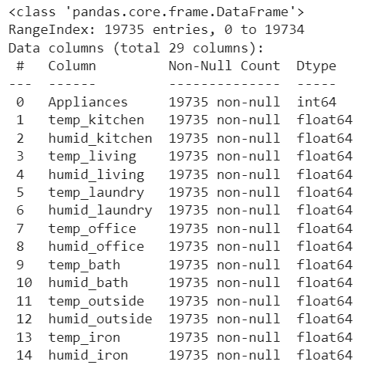
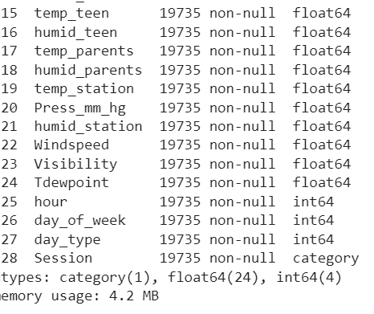
DATA INFO :
Notes:
Our dataset has no null values.

Slide 10
Exploratory Data Analysis

Slide 11
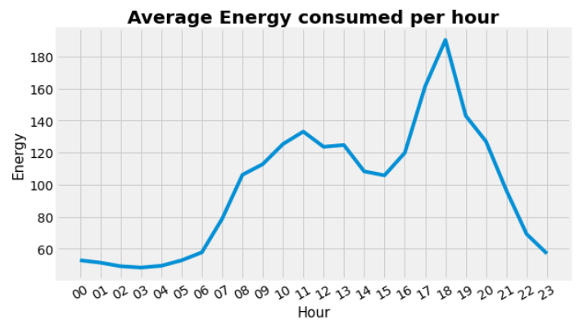
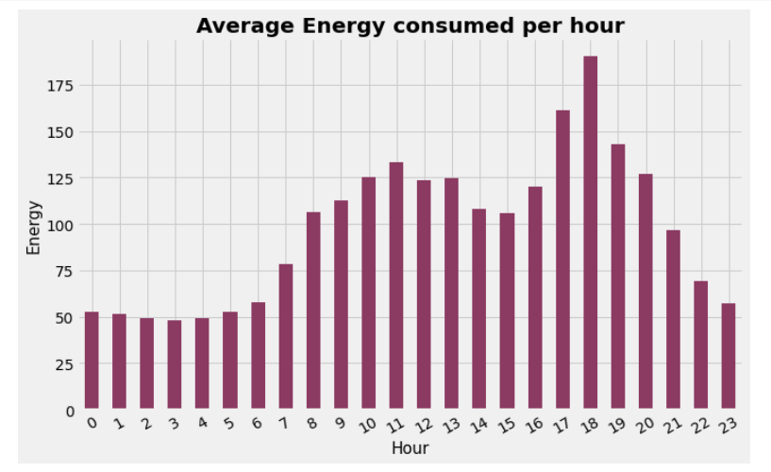
CONSUMPTION OF ENERGY :

Slide 12
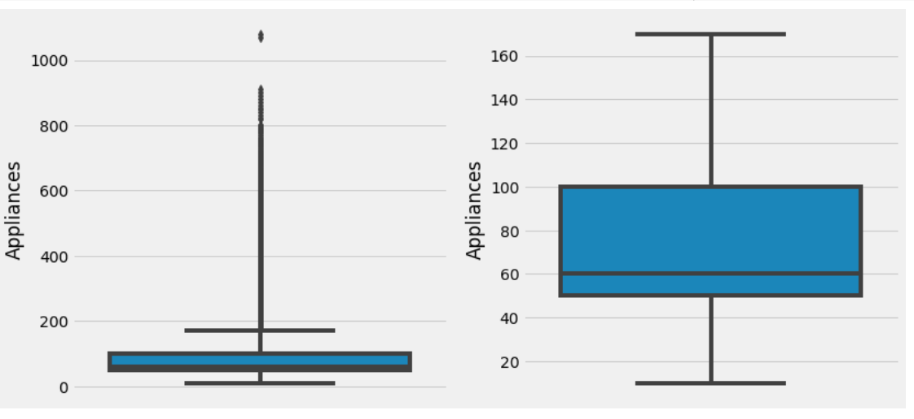
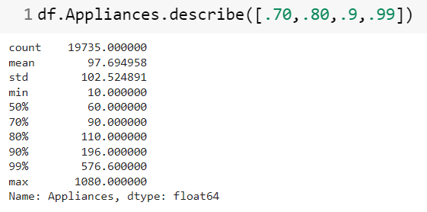
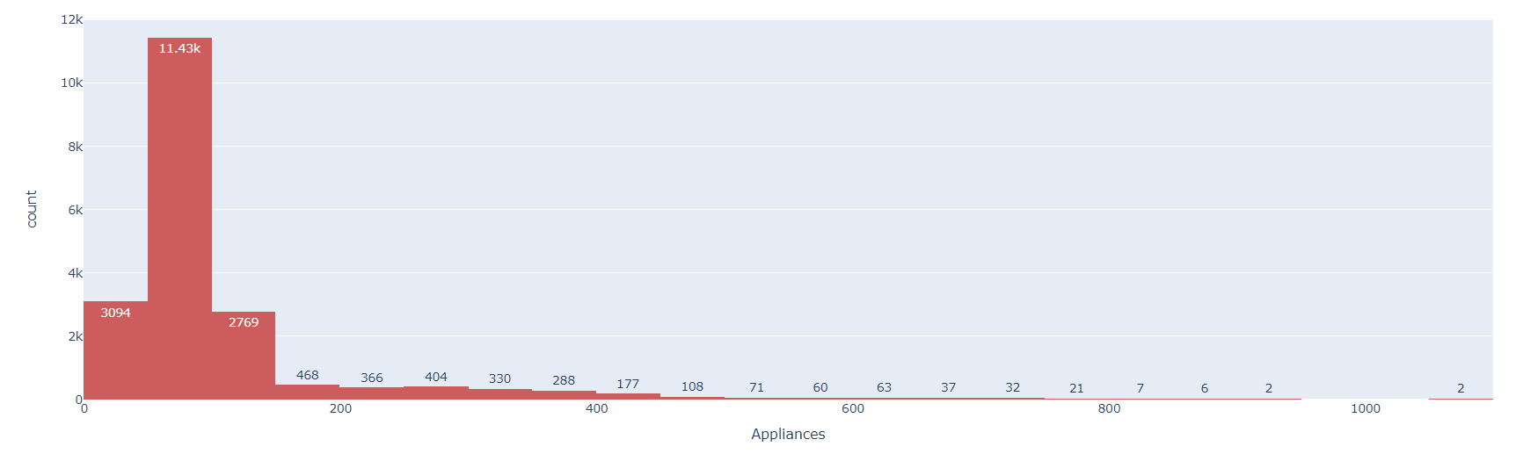
ANALYSIS OF APPLIANCES :

Slide 13
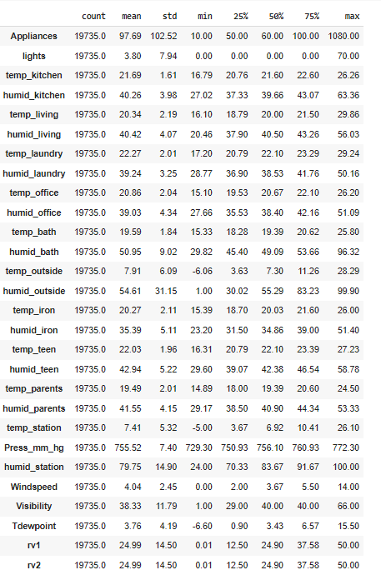
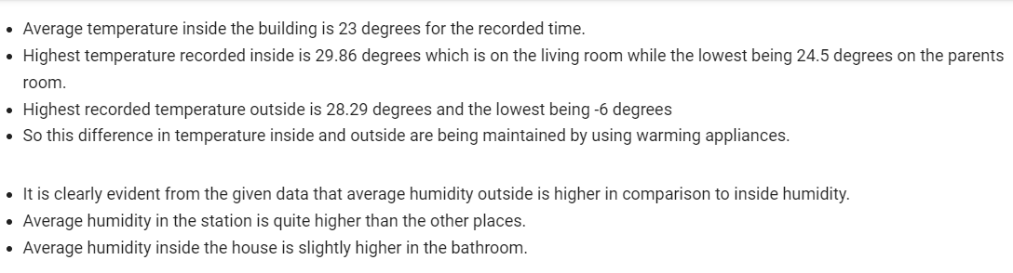
Corelation and observations:

Slide 14
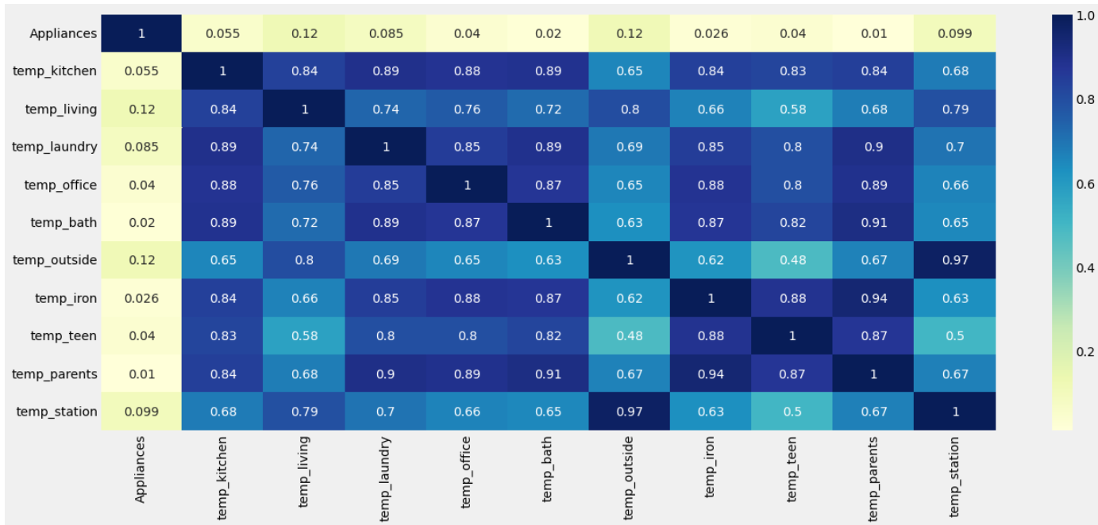
CORRELATION PLOT FOR ‘APPLIANCES’ AND TEMPERATURES:

Slide 15
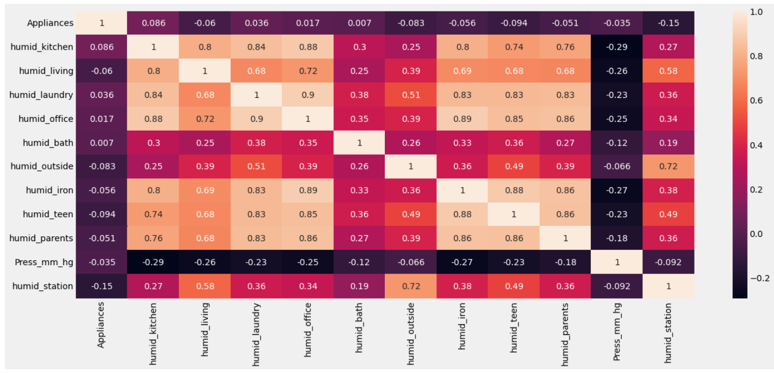
CORRELATION PLOT FOR ‘APPLIANCES’ AND HUMIDITY:

Slide 16
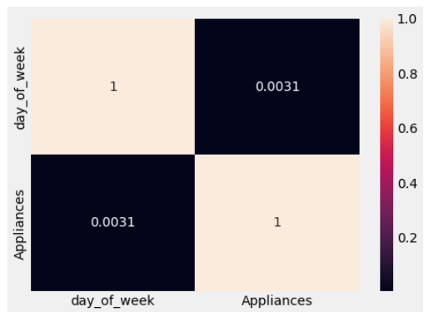
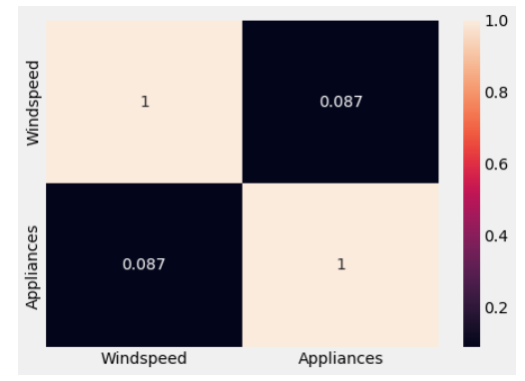
CORRELATION PLOT FOR ‘APPLIANCES’ AND DAY OF WEEK:
CORRELATION PLOT FOR ‘APPLIANCES’ AND WINDSPEED:

Slide 17
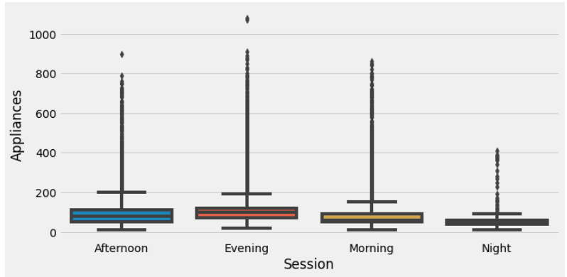
SESSION VS APPLIANCES:

Slide 18
Feature Engineering

Slide 19
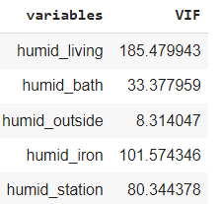
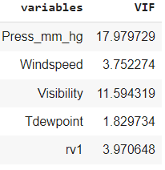
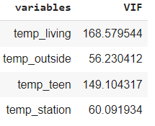
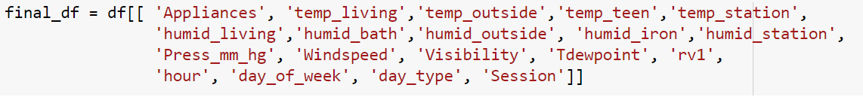
VARIABLE SELECTIONS:

Slide 20
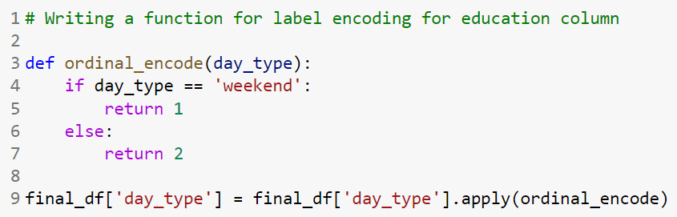
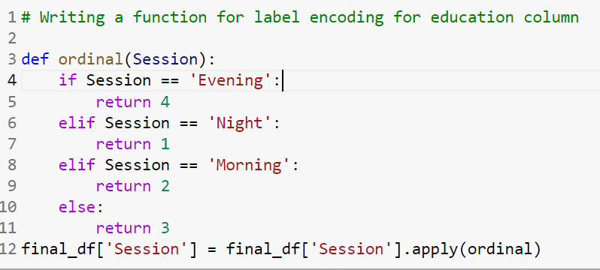
ENCODING CATEGORICAL VARIABLES:

Slide 21
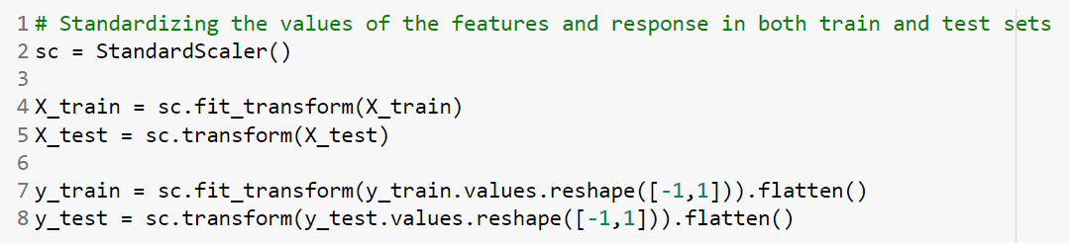
STANDARDIZATION:

Slide 22
MODEL BUILDING

Slide 23
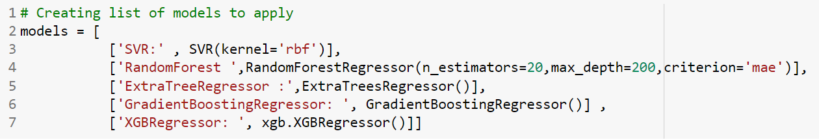
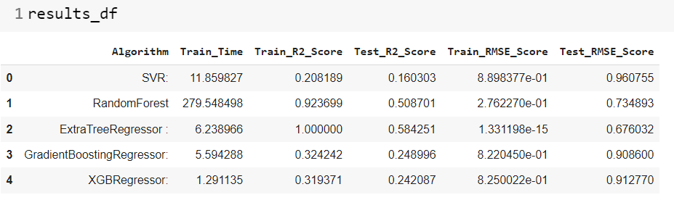
MODELS AND FINAL RESULTS:
Implemented algorithms overfits…

Slide 24
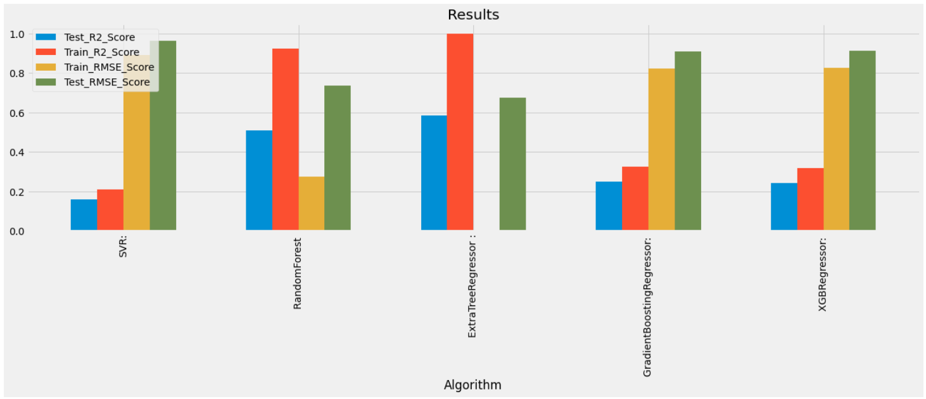
GRAPHICAL REPRESENTATION OF MODELMETRICS:

Slide 25
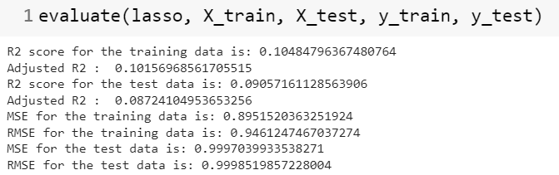
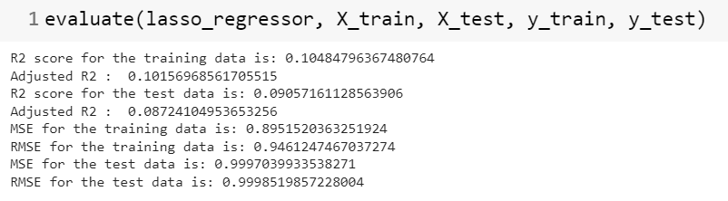
REGULARIZATION TECHNIQUES: LASSO

Slide 26
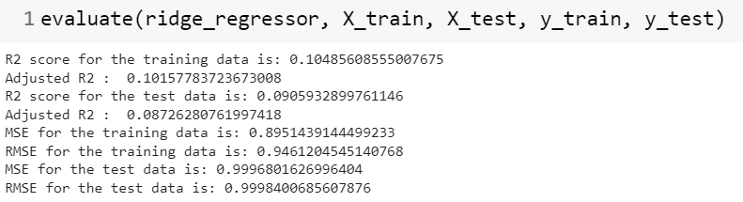
REGULARIZATION TECHNIQUES: RIDGE

Slide 27
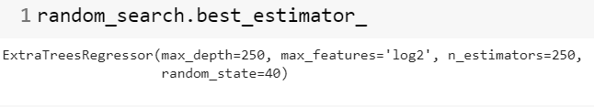
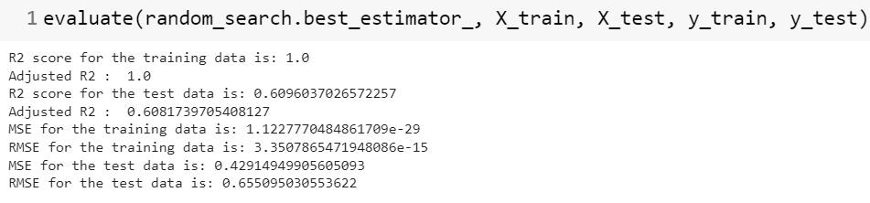
HYPERPARAMETER TUNED EXTRATREESREGRESSOR:

Slide 28
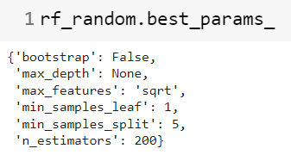
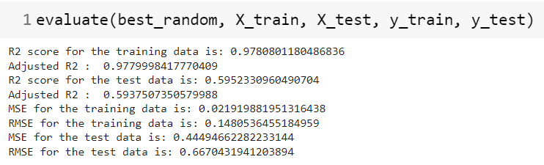
HYPERPARAMETER TUNED RANDOMFORESTREGRESSOR:

Slide 29
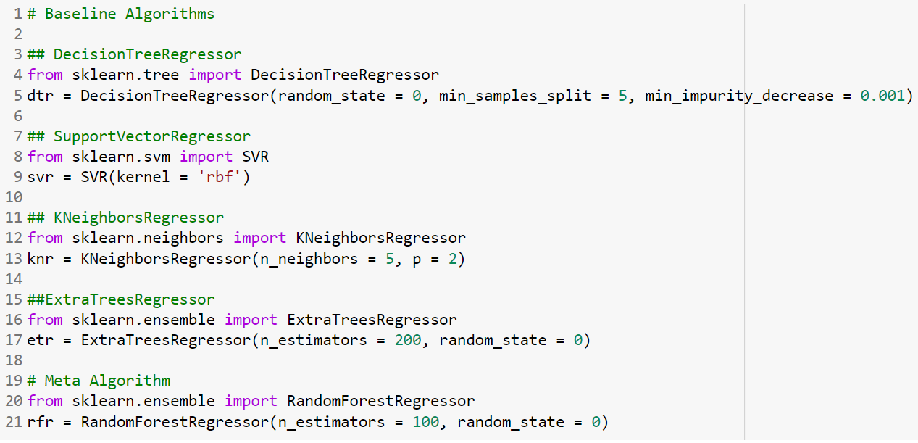
STACKING:

Slide 30
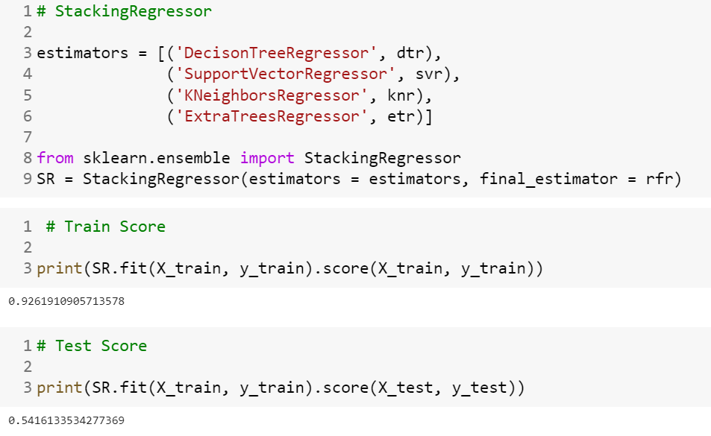
STACKING:

Slide 31
Thank You

